Slide 1
Electromagnetic Waves Fundamentals

Slide 2
Objectives
Explain the basic principals of radio frequency transmissions
Describe the different types of analog and digital modulation
List the units of measurement for radio frequency transmissions
Describe how radio frequency waves behave and the impact of these behaviors on transmissions

Slide 3
Radio Frequency
Understanding principles of radio wave transmission is important for:
  Troubleshooting wireless LANs
  Creating a context for understanding wireless terminology

Slide 4
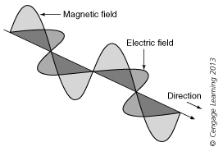
What Are Electromagnetic Waves?
Electromagnetic wave: Travels freely through space in all directions at speed of light
  Consists of an electric field and a magnetic field that are perpendicular to each other
Electromagnetic wave

Slide 5
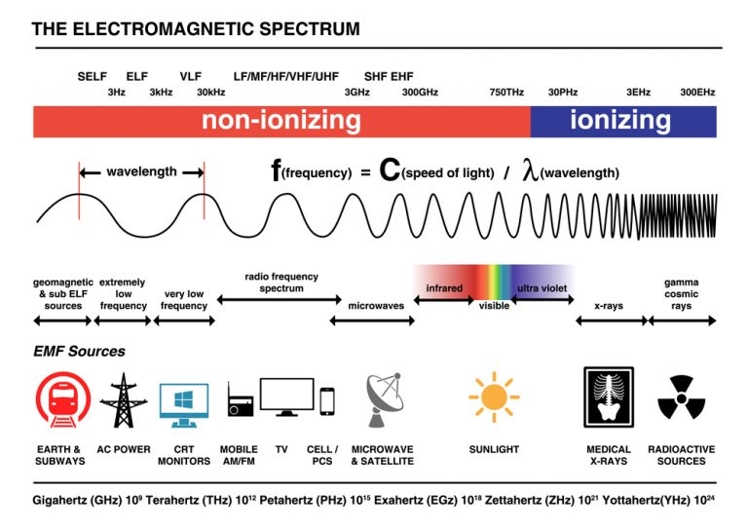
The Electromagnetic Spectrum

Slide 6
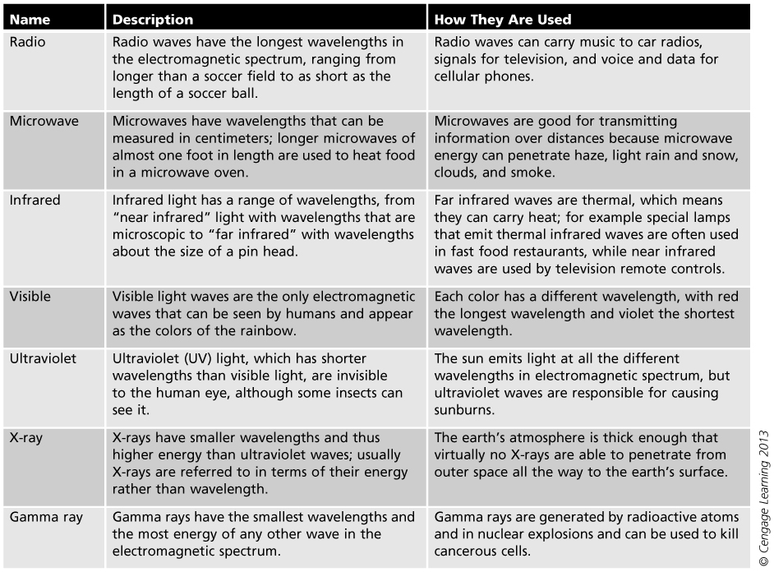
Table Electromagnetic spectrum properties

Slide 7
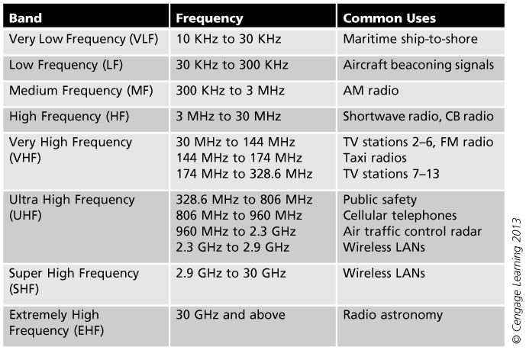
Table Common radio frequency bands

Slide 8
The Electromagnetic Spectrum
A license is normally required from the FCC to send and receive via a specific frequency
  Unlicensed bands: parts of the radio spectrum that are available nationwide to all users without requiring a license
  FCC does impose power limits on devices using the unregulated bands (reduces their range)
Unlicensed National Information Infrastructure (UNII) band: intended for devices that provide short-range, high-speed wireless digital communications

Slide 9
Electromagnetic Wave Characteristics
Characteristics of electromagnetic waves:
  Continuous - does not repeatedly start and stop
  Cycle - When wave completes trip and returns back to starting point it has finished one cycle
Cycles are illustrated by an up-and-down wave called an sine wave
All electromagnetic waves share the same four characteristics: wavelength, frequency, amplitude, and phase

Slide 10
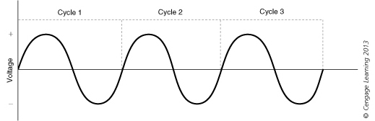
Electromagnetic Waves
Sine wave

Slide 11
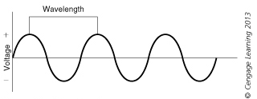
Wavelength
Wavelength – distance between the wave’s peaks
  Can also be measured from anywhere in the wave as long as it is at the same point in each cycle
Wavelength

Slide 12
Frequency
Frequency: Rate at which an event occurs
  Number of times that a wave completes a cycle within a given amount of time
Hertz (Hz): Cycles per second
  Kilohertz (KHz) = thousand hertz
  Megahertz (MHz) = million hertz
  Gigahertz (GHz) = billion hertz
Wavelength and frequency have an inverse relationship
  The higher the frequency, the shorter the wavelength will be and the longer the wavelength, the lower the frequency

Slide 13
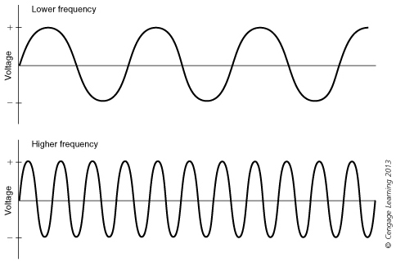
Lower and higher frequencies

Slide 14
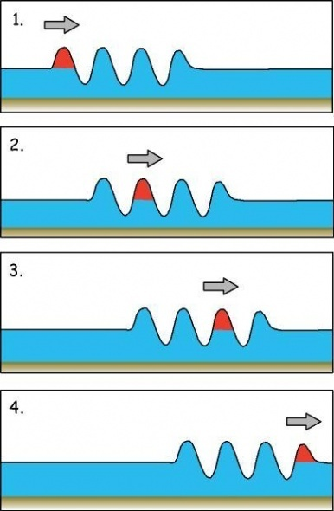
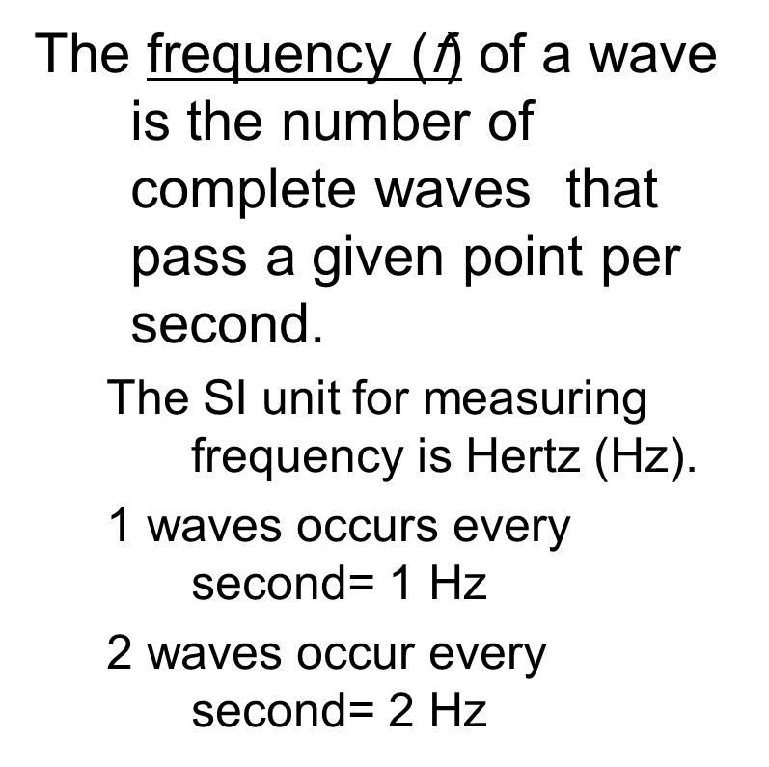

Slide 15
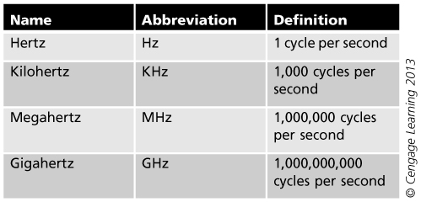
Hertz abbreviations

Slide 16
Humans with normal hearing can hear sounds between 20 Hz and 20,000 Hz. Humans with normal hearing can hear sounds between 20 Hz and 20,000 Hz.
Frequencies above 20,000 Hz are known as ultrasound.
When your dog tilts his head to listen to seemingly imaginary sounds, he is tuning in to ultrasonic frequencies, as high as 45,000 Hz.
Bats can hear at among the highest frequencies of any mammal, up to 120,000 Hz.
At the other end of the spectrum are very low-frequency sounds (below 20 Hz), known as infrasound. Elephants use infrasound for communication, making sounds too low for humans to hear. Because low frequency sounds travel farther than high frequency ones, infrasound is ideal for communicating over long distances. 120,000 Hz. They use ultrasonic vocalizations as sonar, allowing them to pursue tiny insects in the dark without bumping into objects.
At the other end of the spectrum are very low-frequency sounds (below 20 Hz), known as infrasound. Elephants use infrasound for communication, making sounds too low for humans to hear. Because low frequency sounds travel farther than high frequency ones, infrasound is ideal for communicating over long distances.

Slide 17
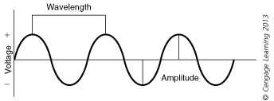
Amplitude
Amplitude: the magnitude of change of the wave
  Is measured by how high or how deep the wave is
  Is essentially a measure of the strength of an electromagnetic wave’s signal
Different types of transmissions require different signal strengths

Slide 18
Phase
Phase: the relationship between at least two signals that share the same frequency yet have different starting points
  Two signals that have the same peaks and valleys are called in phase
  If peaks and valleys do not match they are out of phase
  If two signals are the complete opposite of each other the first signal is in phase
    Second signal is 180 degrees out of phase

Slide 19
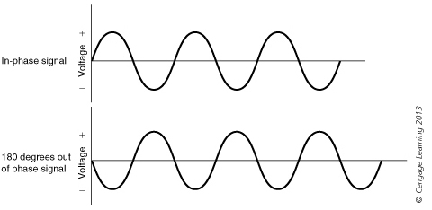
In phase and 180 degrees out of phase

Slide 20
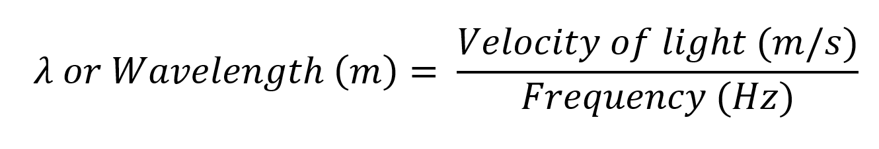
Calculation
λ (Lambda) = Wavelength in meters
C or Velocity of Light = Speed of Light (299,792,458 m/s)
300,000 km/sec
Frequency (Hz): The frequency in Hz

Slide 21

What is the frequency of microwaves with a wavelength of 0.01 m?
v =3 x 10⁸ m/s =300,000,000 m/s
λ = 0.01 m
f = 300,000,000 / 0.01
=30,000,000,000 Hz
=30 GHz

Slide 22
Summary
A form of energy known as an electromagnetic wave carries elements through the universe
All electromagnetic waves share the same four characteristics
Electromagnetic waves may be categorized by their frequency, wavelength

